Slide 1


Final Group Project
EEOB/BCB 546 SPRING 2024
Ginushika, Rabsa, Taylor, Daniel Moraes, Puja and Daniel Montgomery

Slide 2
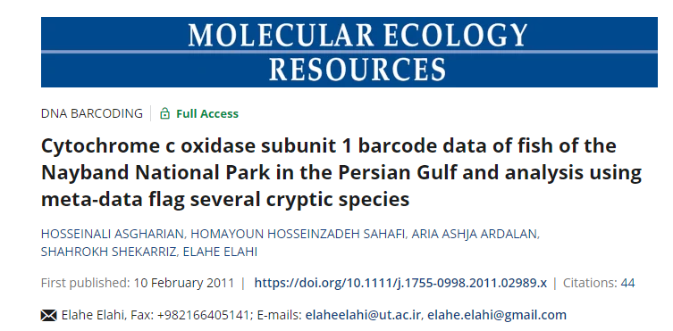
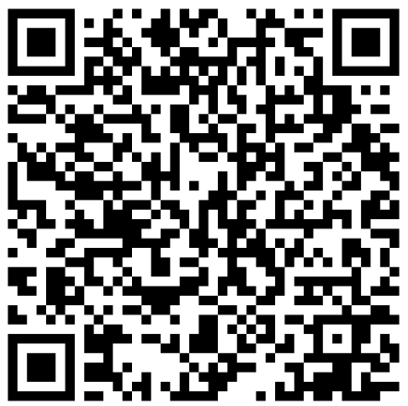
Manuscript selected
Access the manuscript
BCB 546

Slide 3
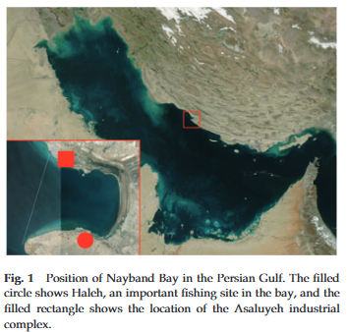
Biological question
Industrial activities, ecological considerations, and the Fish Barcode of Life campaign resulted in need to identify fish species present in Persian Gulf, Iran
Create a catalogue of fish species living in Nayband Bay for species identification
Some species are near threatened and vulnerable (IUCN), catalog will help with rehabilitation
The Bay located in an energy zone that industrial waste is discharged
187 individuals examined; compare 16 selected species to meta-data from Australia, India, China, and South Africa (potential six cryptic species)
BCB 546

Slide 4
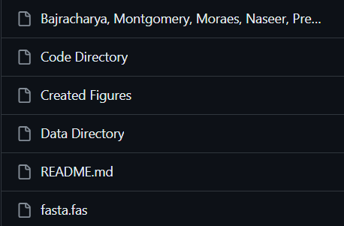
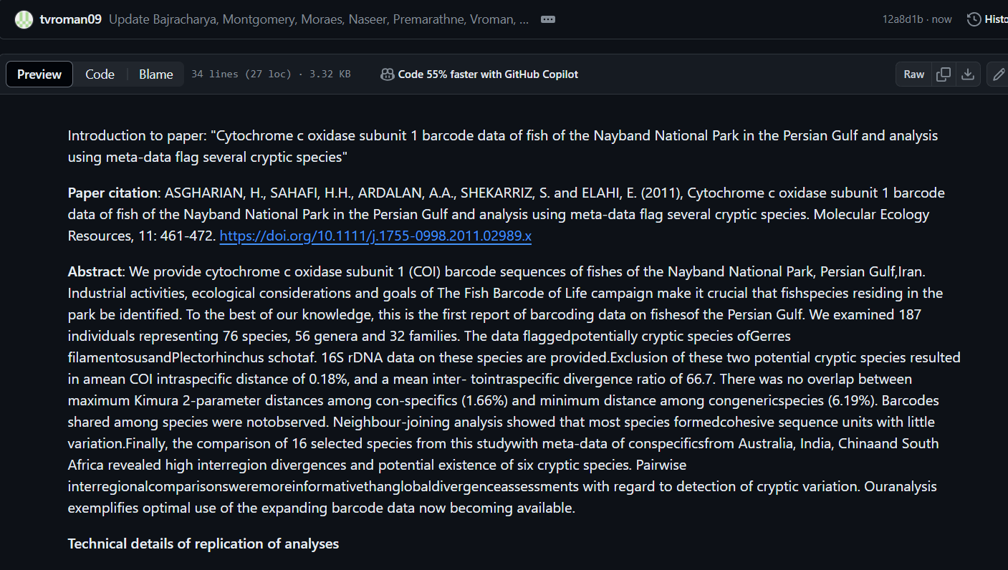
Documentation
Includes:
Technical details of replication
Summary of replication accomplished
BCB 546

Slide 5

Workflow
Goal: Reproduce Figures 2, Figure 3, and Figure 4 using original software (MEGA) or more familiar software
Figure 2 (phylogenetic tree): Ginushika and Rabsa
Figure 3 (phylogenetic tree): Daniel Moraes and Taylor
Figure 4 (bar plot): Puja and Daniel Montgomery
Use original data with original software to reproduce figures
If original software not ideal – try R/Python to reproduce figure
Reflect on why differences occur between original software and R/Python
BCB 546

Slide 6
Reproduce Tables 1 and 3
Daniel Montgomery
BCB 546

Slide 7
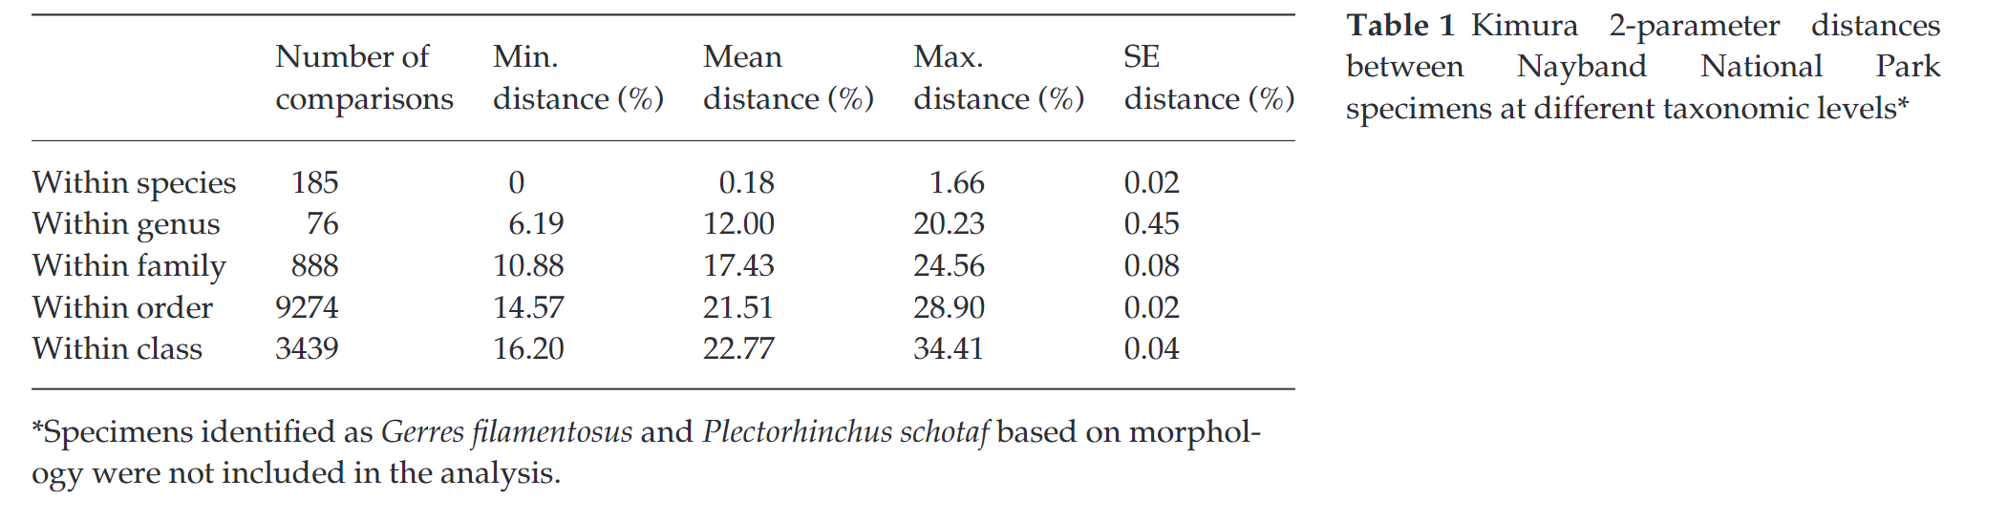
Table 1
 | Number of Comparisons | Min. distance (%) | Mean distance (%) | Max Distance (%) | SE Distance (%)
Within Species | 207 | 0.00 | 1.23 | 14.78 | 0.02
Within Genus | 64 | 6.36 | 12.11 | 21.49 | 0.07
Within Family | 767 | 11.50 | 18.03 | 24.22 | 0

Slide 8
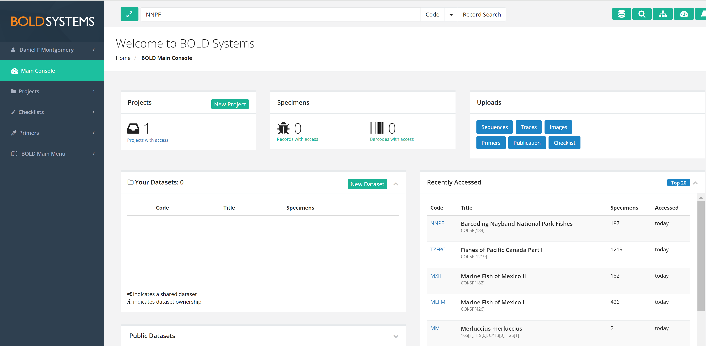

Slide 9
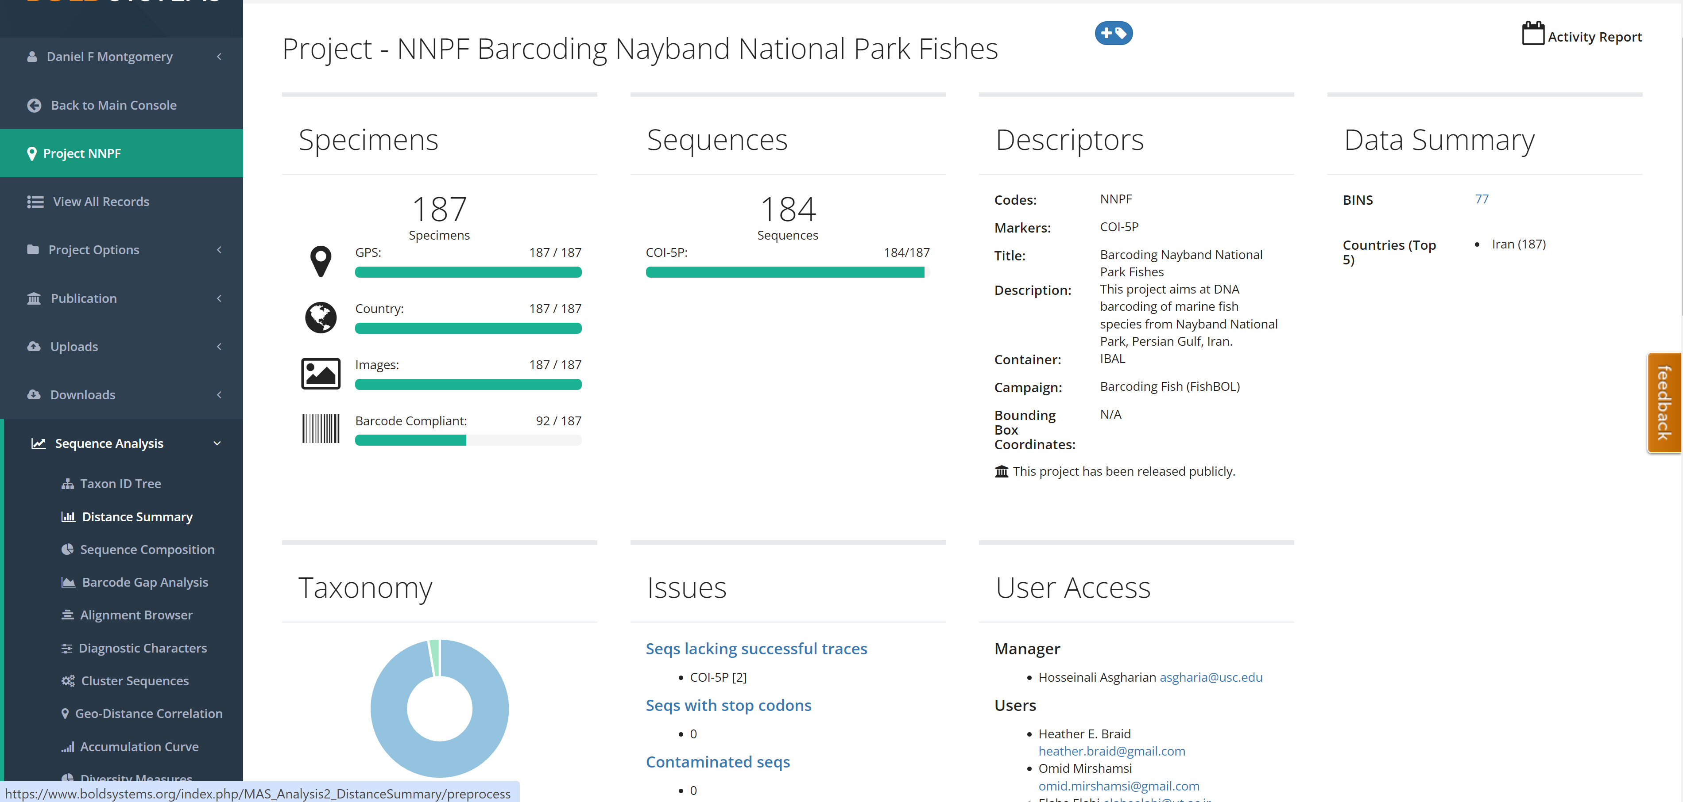

Slide 10
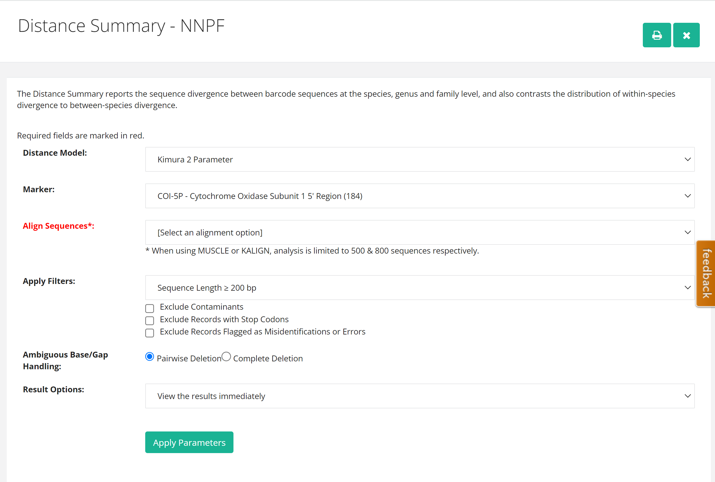

Slide 11
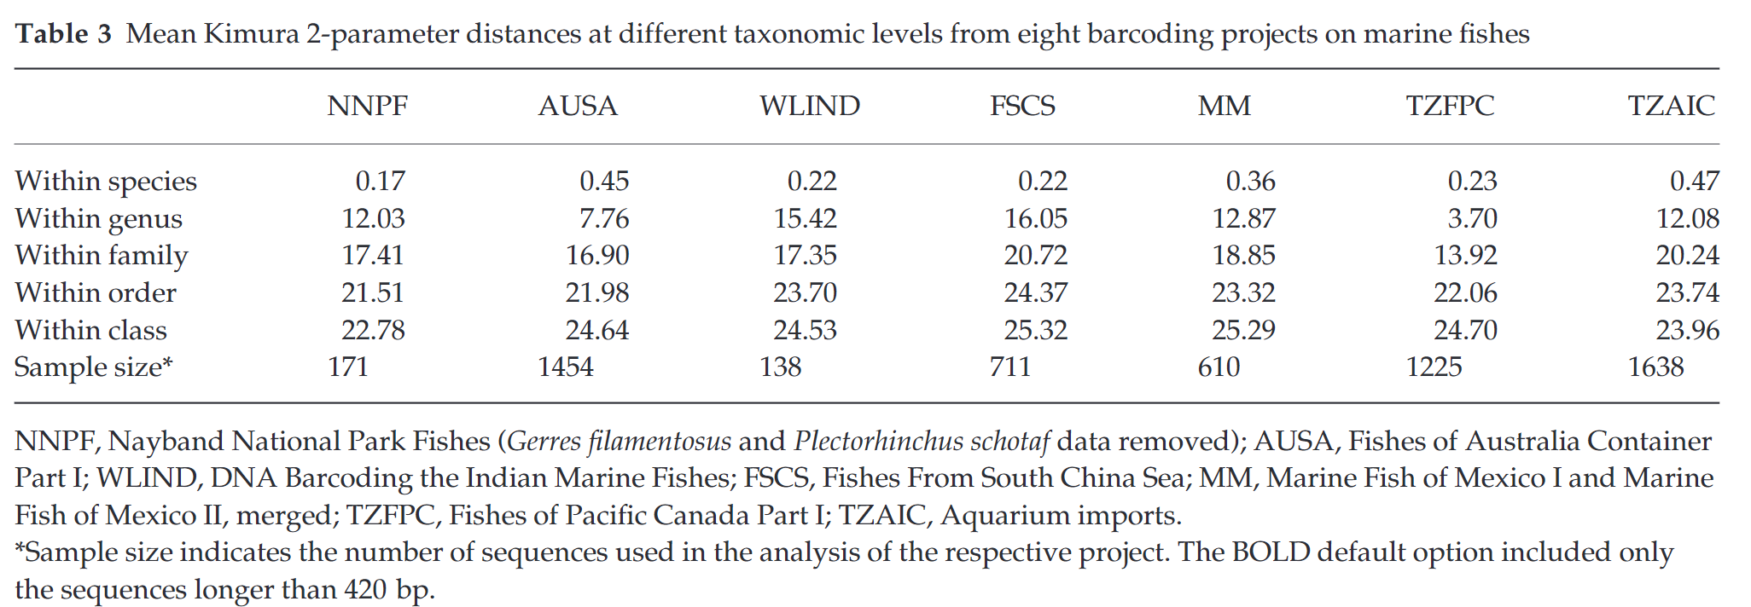
Table 3
 | NNPF | AUSA | WLIND | FSCS | MM | TZFPC | TZAIC
Within Species | 1.23 | 0.47 | 0.54 | 0.25 | 0.36 | 0.22 | 0.38
Within Genus | 12.11 | 8.98 | 14.7 | 14.27 | 12.71 | 3.67 | 11.22
Within Family | 18.03 | 19.09 | 17.32 | 19.87 | 19.06 | 13.99 | 18.24

Slide 13
Reproduce Figures 2
Ginushika
BCB 546

Slide 14
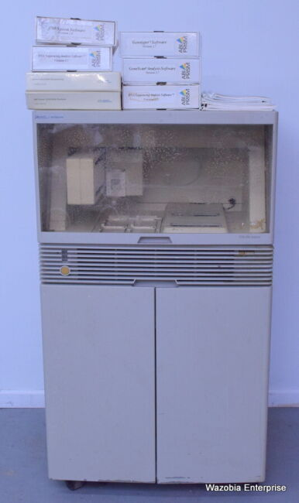
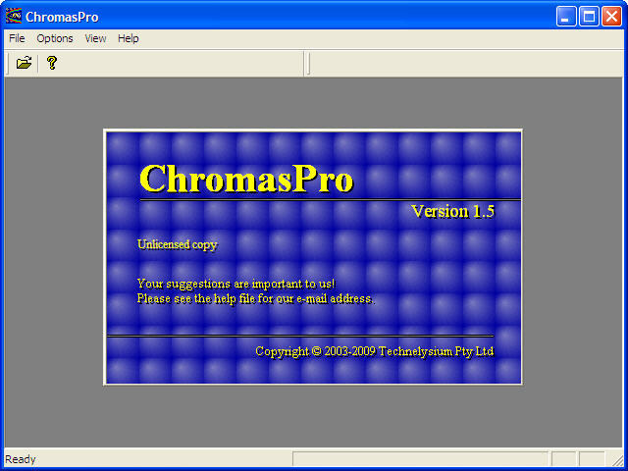
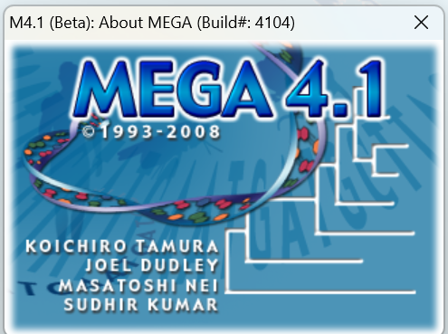
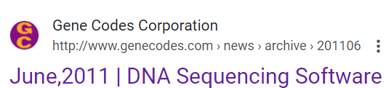

Barcode sequence Analysis
ABI prism 3700 dna analyzer
Check chromatograms for reading errors
Trim the sequences
Align the sequences
Sequencing cytochrome c oxidase subunit 1
Fasta alignment file

Slide 15
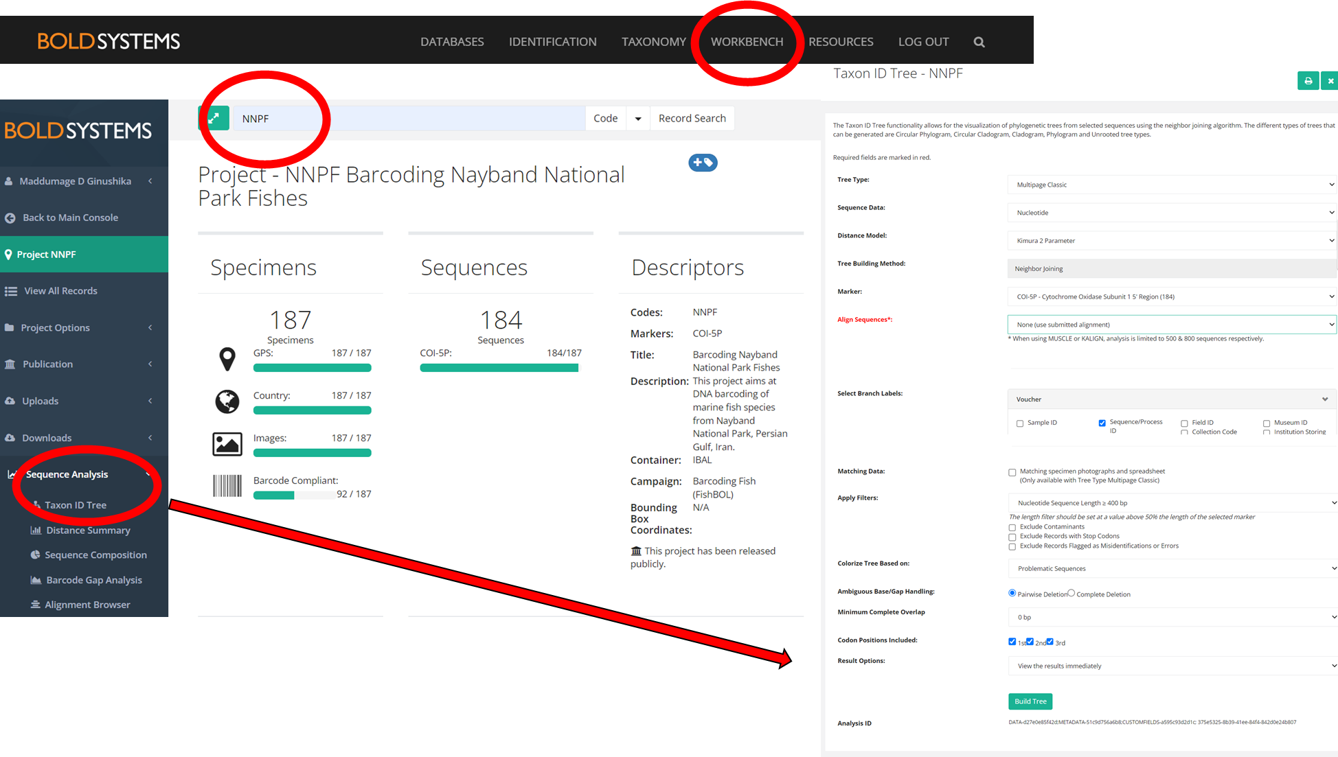

Slide 16
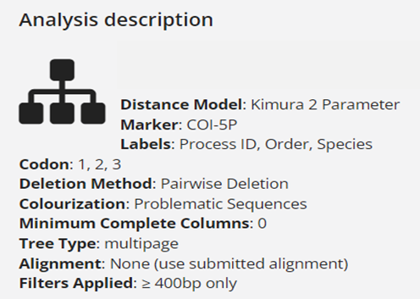
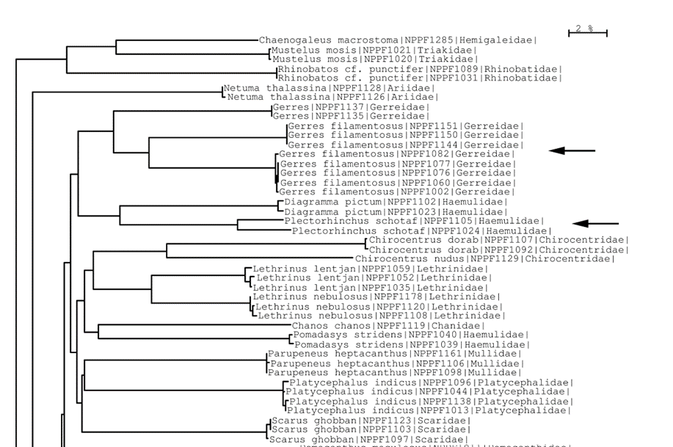
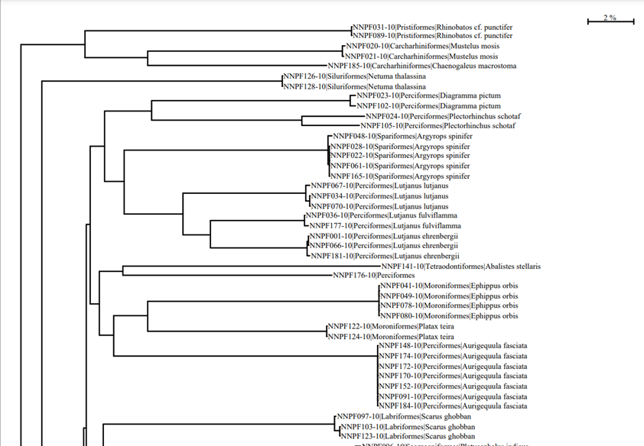
Bold Systems Results – Neighbour joining tree
Topography
Branch length
Branch order
Clades
Original Results
Reproduced Results

Slide 17
Reproduce Figures 2
Rabsa
BCB 546

Slide 18
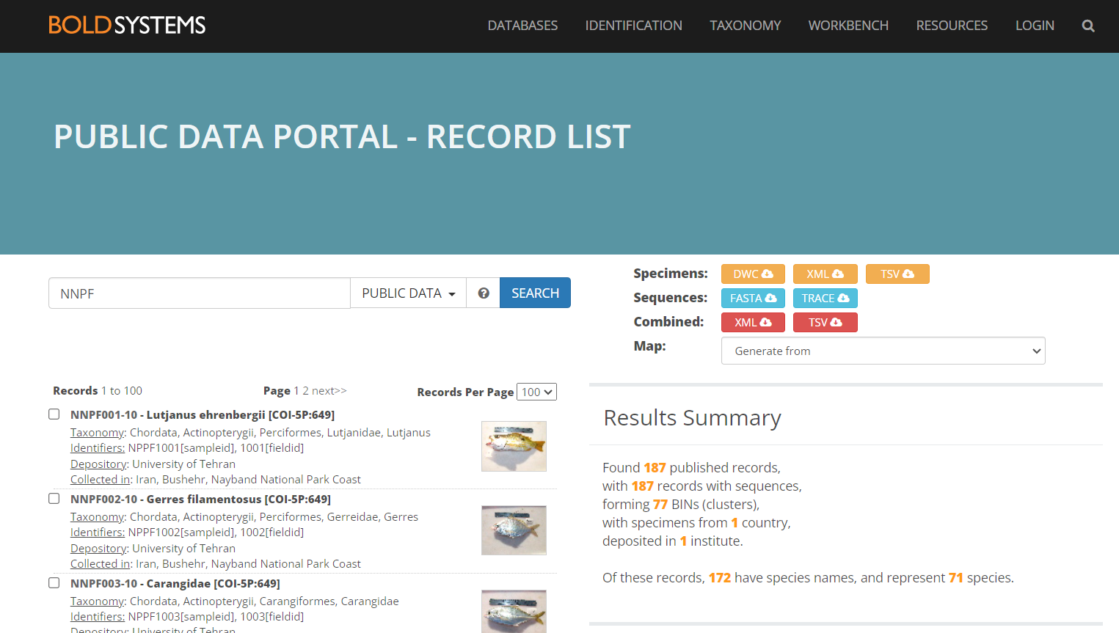
Data Processing for Figure 2
The project ID was provided in the paper, data publicly available in BOLD SYSTEMS database

Slide 19
Data Processing for Figure 2
I chose to download TSV file, includes necessary metadata to replicate taxa
Created FASTA file using sample id and saved custom taxa in a separate tsv file to annotate tree
Tree Building for Figure 2
Two methods
R Studio
Command Line

Slide 20
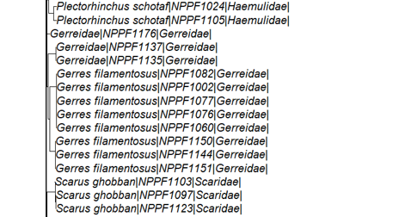
RStudio Results
Original Results
Reproduced Results

Slide 21
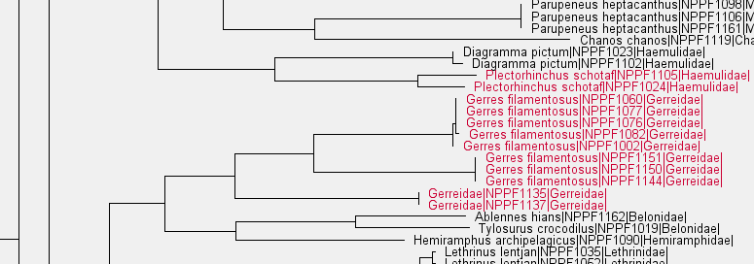
Command Line Results
Original Results
Reproduced Results

Slide 22
Issues and Concerns
Some entries in the BOLD SYSTEMS TSV file did not include a sequence
It is very difficult to manipulate the tree in R regarding expansion and annotation
Also hard to visualize clades
 | Bold System | R | Command line
Prior knowledge | No need | Required | Required
Use of mentioned parameters | In built | Decided by the user | Decided by the user
Customizing the figure | Not much of capacity | Not much of capacity | Moderate capacity
Executing convenience | Easy | Moderate | High capacity (FigTree)

Slide 23
Reproduce Figures 3
Daniel Moraes
BCB 546

Slide 24
Procedure to obtain the sequences for Figure 3
In the Supporting information from the manuscript, there is a file called “MEN_2989_sm_tS2.xls”
In this file was possible to obtain only 6 sequences at the column named “Genbank Num” by looking at the “Sample ID” described in the phylogenetic tree in Figure 3.
Then we searched in NIH in search each Genbank number https://www.ncbi.nlm.nih.gov/. For example, for Sample ID “NPPF1048,” we entered “HQ149794”.
How to obtain the other sequences?
BCB 546

Slide 25
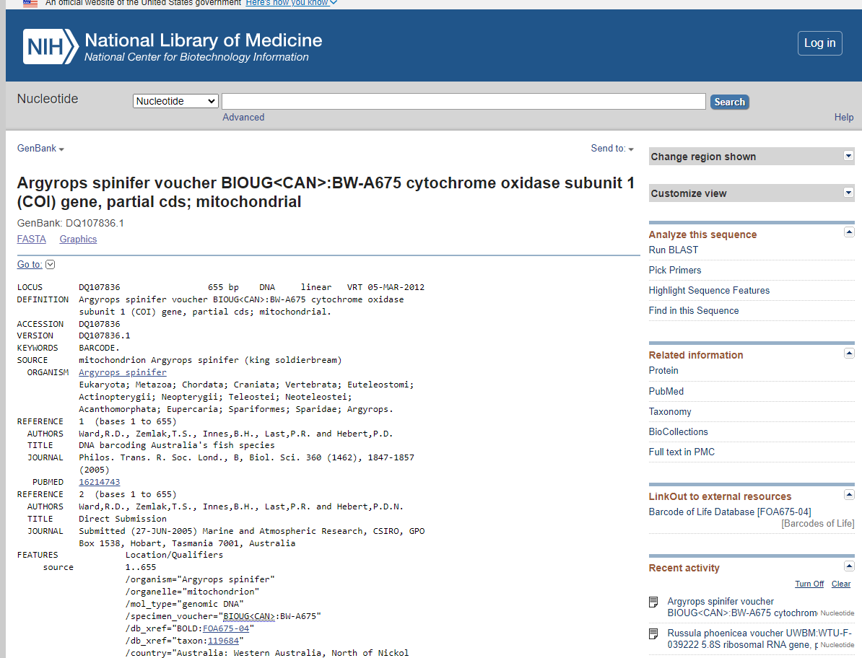
How to obtain the remaining sequences?
For the 8 remaining sequences, we entered each Sample ID in gen Bank
For example, for Sample ID BW-A675, we entered “Argyrops spinifer BW-A675”
BCB 546

Slide 26
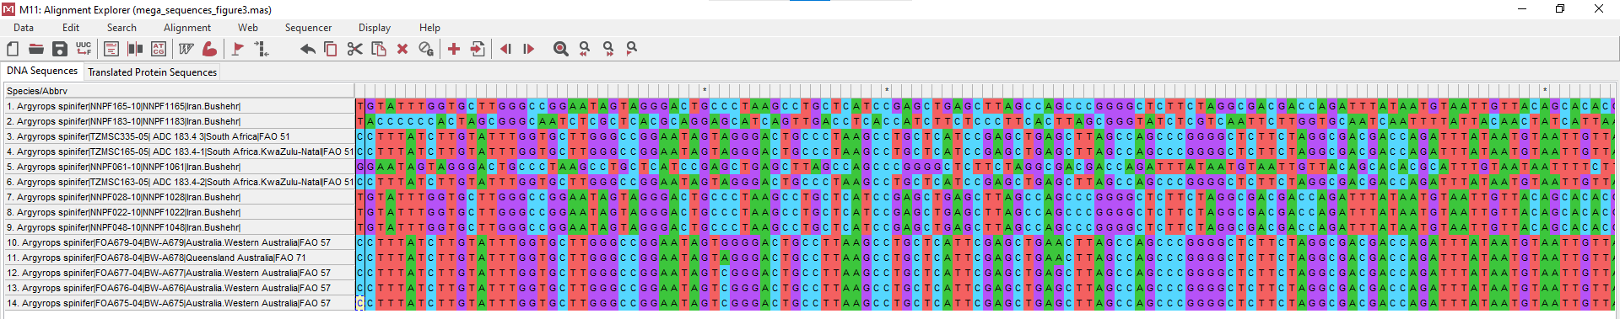
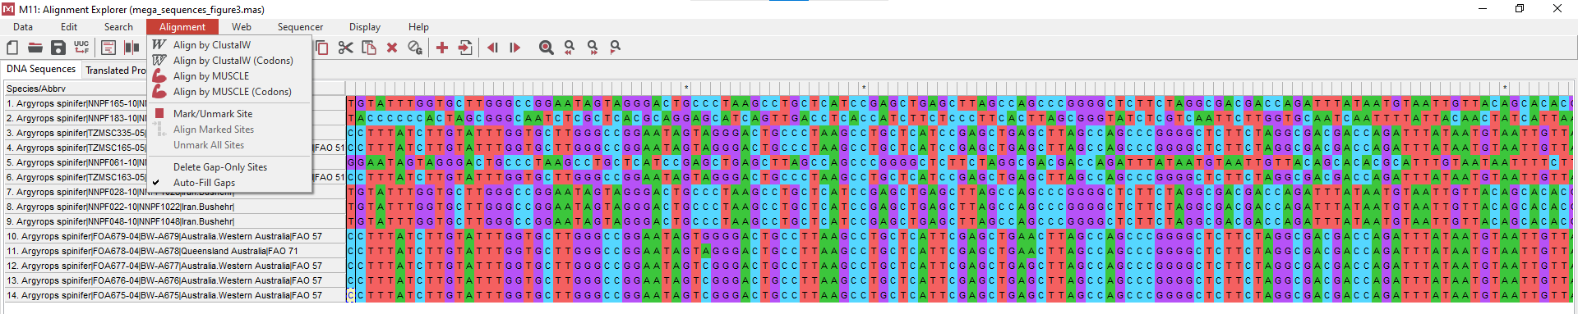
Import the software used in the manuscript
Import the sequences to MEGA- Molecular Evolutionary Genetic Analysis
The version from the manuscript was MEGA 4.0
The current version that we used was MEGA 11
The alignment was conducted by MUSCLE -Not specified in the paper

Slide 27
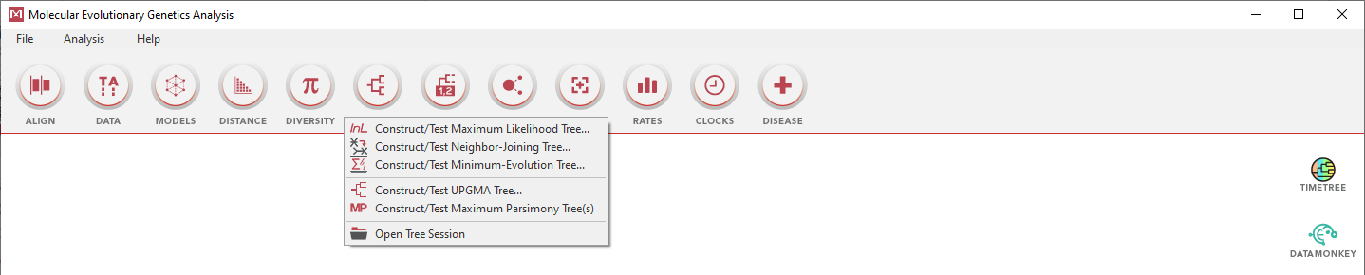
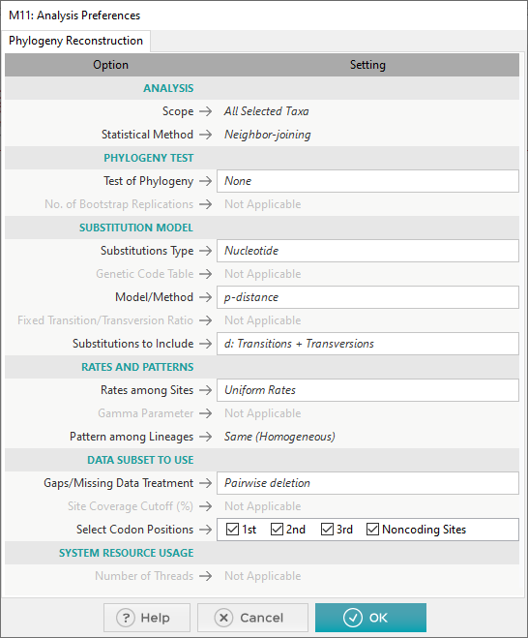
To build the phylogenetic tree
Neighbour-joining (NJ) tree
Model/distance: p-distance
Not specified in the paper
BCB 546

Slide 28
Reproduce Figures 4
Puja
BCB 546

Slide 29
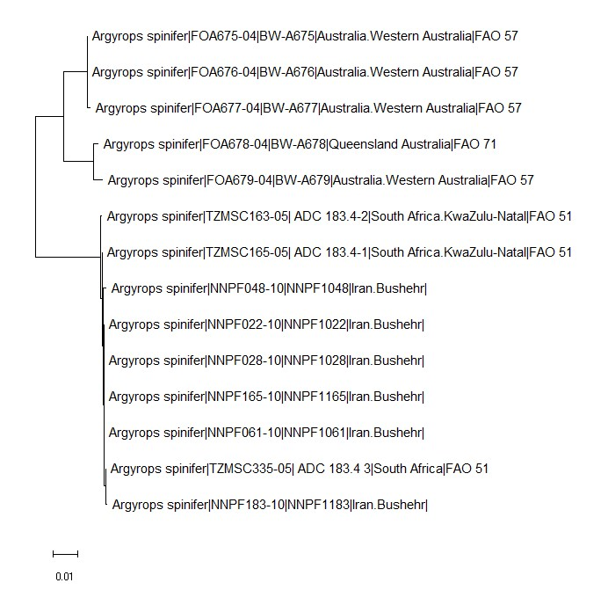
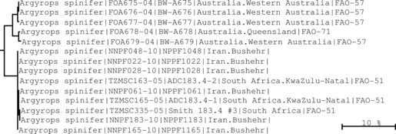
To build the phylogenetic tree
The tree that we got
The tree from the paper
BCB 546

Slide 30
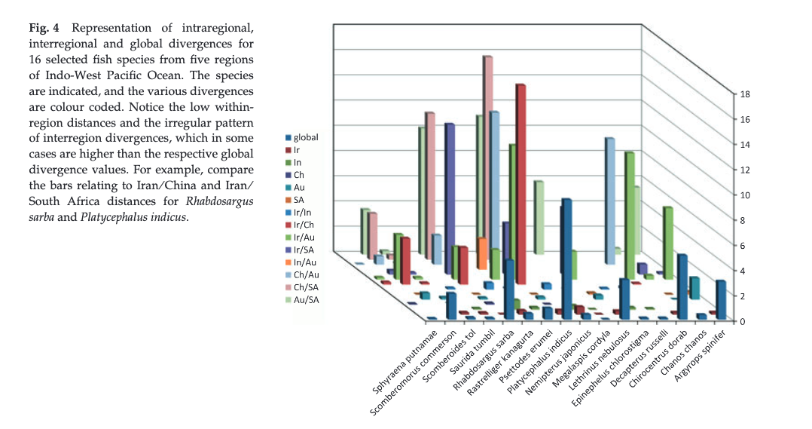
Global, Regional and Interregional Divergence Original Figure

Slide 31
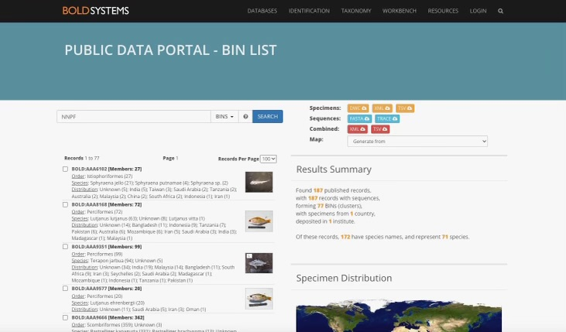
Data Retrieval
In the paper, sequence information from this 5 projects ‘Fishes of Australia Container Part I’, ‘DNA Barcoding the Indian Marine Fishes’, ‘Fishes From South China Sea’ and ‘Overlooked Fishes in Marine Settings in BOLD were used using the BOLD management and analysis system.
However, I couldn’t retrieve that information and used the data from 77 files from the BIN LIST under the same project name NNPF.

Slide 32
Constructing a 3D divergence figure using Python
Combined all 78 TSV files using Unix command in one single TSV file.
Filtered the file by removing all the rows where the species name doesn’t equal to the targeted 16 species
Install Biopython using conda and import Seq, Pairwise Aligner and combination from itertools module.
Calculated the mean global, regional and interregional pair-wise genetic distance for all 16 species
Used matplotlib and mpl_toolkits.mplot3d to visualize the data into 3D figure.

Slide 33
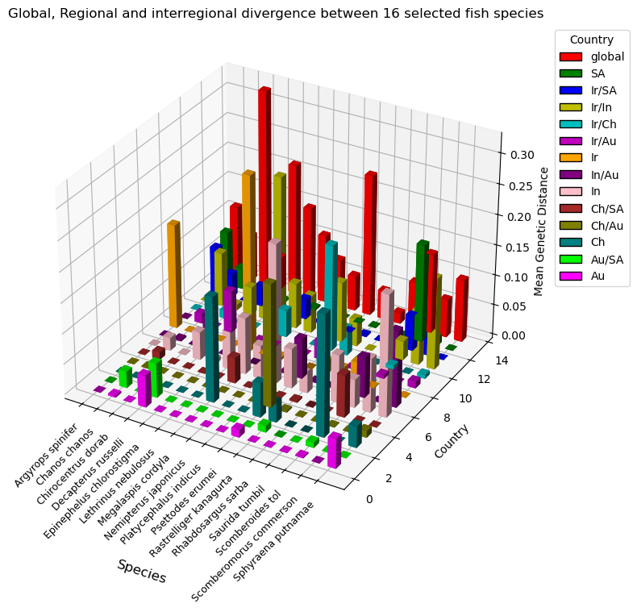
3D divergence figure in Python
Original Figure

Slide 34
Issues faced
In the paper, they talked about the sequence information from the 5 projects but didn't clearly mention where we can retrieve that information.
It was also unclear about which software they used for the visualization of the divergence data.

Slide 35
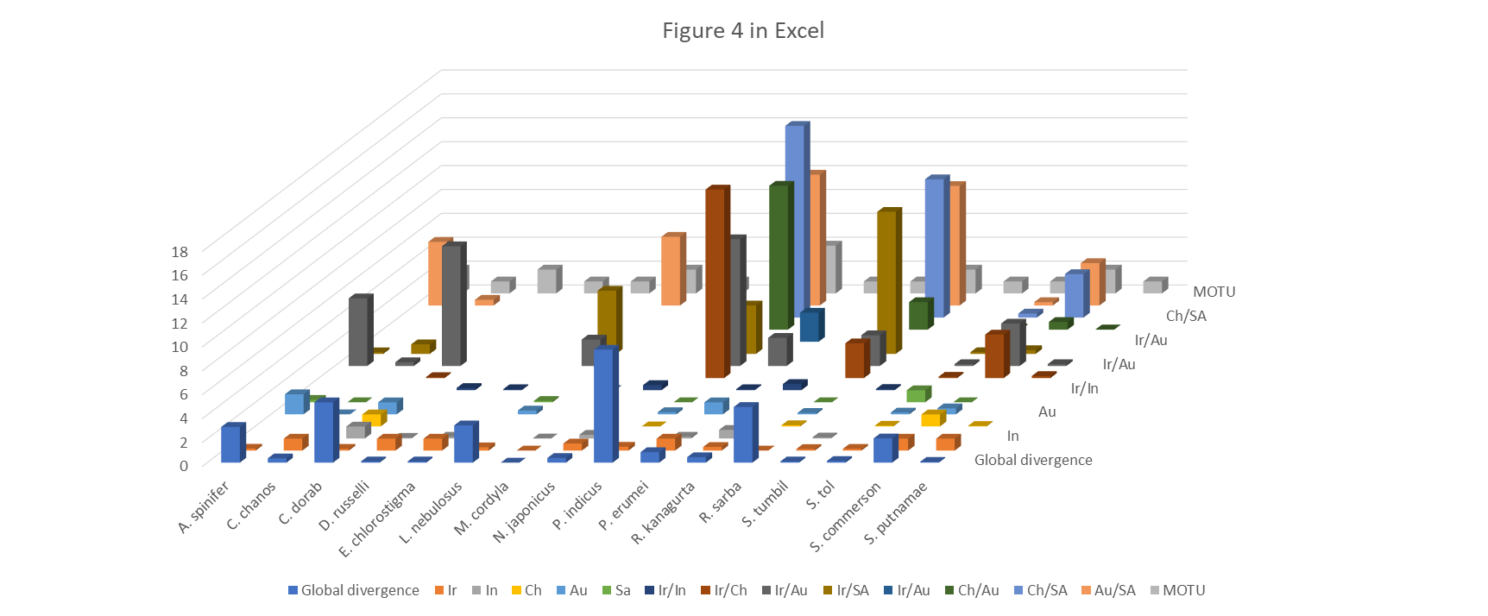
Reproduce Figures 4
Daniel Montgomery
BCB 546

Slide 36
Concluding Thoughts
Aligning the format of the data – data files from various sources and not in one cohesive document
The information was not clear and it was incomplete in the supplemental material
Parameters were too vague
Limited permissions on the files created issues
BCB 546

